Slide 1


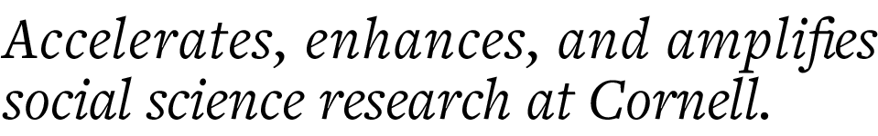
How to make your thesis, dissertation, or scientific paper transparent and reproducible
Florio Arguillas, Ph.D.
foa2@cornell.edu
Kimberly Williams
khw44@cornell.edu

Slide 2
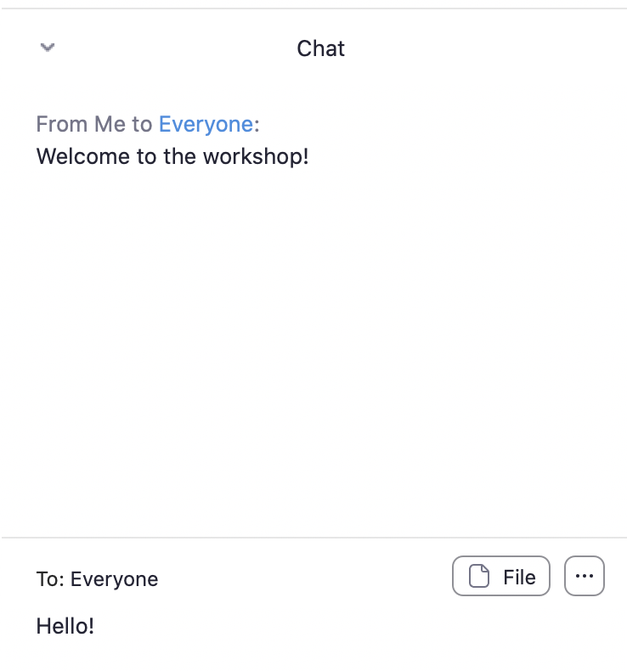
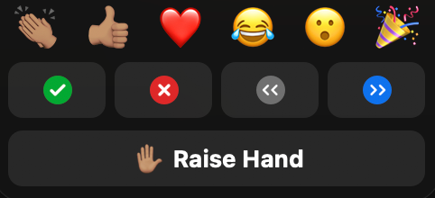
Use reaction emojis to express yourself without having to use the mic. If you would like to speak to the group, use the “Raise Hand” button.
Mute your microphone whenever you are not speaking to the group.
Keep the chat window open. Feel free to send questions or comments via chat at any time.
For immediate technical issues, send a direct chat to Kimberly.
The buttons that appear on your screen may vary a little. If you find you are missing a critical button, you may need to update the Zoom client application on your computer workstation.

Slide 3

I registered for this workshop because...

Slide 4
Outline of the workshop
Address the reasons you registered for this workshop
Define transparency and reproducibility
Discuss the importance of preparing high-quality reproduction materials
Introduce you to CCSS Results Reproduction Service
Walk you through the steps of preparing high-quality Reproduction Materials package
Discuss file, documentation, data, code, output quality reviews
Common mistakes in manuscripts and errors in codes
Hands-on exercises on making transparent and reproducible research.

Slide 5
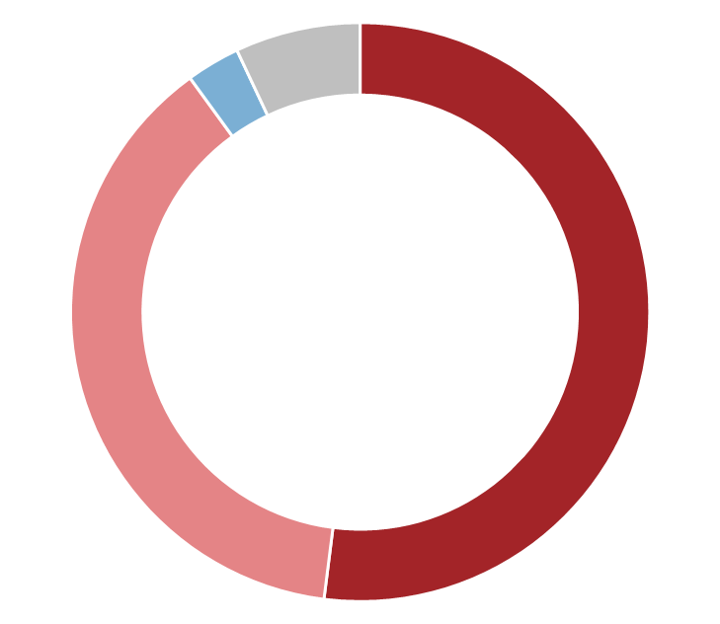
IS THERE A REPRODUCIBILITY CRISIS?
7%
Don’t know
3%
No, there is no crisis
52%
Yes, a significant crisis
1,576
researchers surveyed
38%
Yes, a slight crisis
Baker, M. (2016). 1,500 scientists lift the lid on reproducibility. Nature, 533(7604), 452–454. https://doi.org/10.1038/533452a

Slide 6
Transparency
Definition:
to make the process of research – including data collection, coding, and analysis – clearly visible to all readers
provides readers full access to the data, methodology (including coding and analysis scripts), and, whenever possible, tools used in data analysis
The end goal is to make research as open, understandable, and clearly replicable as possible
~
=
</>
https://ejournals.bc.edu/ojs/index.php/jtla/pages/view/transparency

Slide 7

Pre-Registration of Analysis plan
https://cos.io/prereg/
“When you preregister your research, you're simply committing to your plan in advance, before you gather data. Preregistration separates hypothesis-generating (exploratory) from hypothesis-testing (confirmatory) research. Both are important, but the same data cannot be used to generate and test a hypothesis, which can happen unintentionally and reduce the clarity and quality of your results. Removing these potential conflicts through planning improves the quality and transparency of your research, helping others who may wish to build on it.”
http://help.osf.io/m/registrations/l/524205-register-your-project

Slide 8
Citation Transparency Making sure that every article you’ve used in the study are cited in your reference section, cite the specific pages used, if possible, especially in thesis or dissertation. Of course, follow publisher formatting rules.
Data Citation
Cite ALL DATA used in your study in the reference/bibliography section or your manuscript and in your Readme file.
https://data.research.cornell.edu/content/data-citation

Slide 9
methodological reproducibility
validation
PREPRODUCIBILITY
REPLICABILITY
direct replication
statistical reproducibility
COMPUTATIONAL REPRODUCIBILITY
REPEATABILITY
conceptual replication
empirical reproducibility
VERIFICATION

Slide 10
Reproducibility (Computational Reproducibility)
Definition:
Changes in scientific practice and reporting standards to accommodate the use of computational technology…in particular whether the same results can be obtained from the data and code used in the original study.
</>
Stodden, V. (2015). Reproducing statistical results. Annual Review of Statistics and Its Application, 2(1), 1–19. https://doi.org/10.1146/annurev-statistics-010814-020127

Slide 11
Why prepare high-quality RM?
For You
Excellent Practice:
Ability to document your own code (Vilhuber, 2017 slide 3)
For yourself in [t+n]
For others on the team
For Disclosure Avoidance personnel
Robustness to errors
Discovery of error in an early step at a late stage of the research is easier to fix (Vilhuber, 2017 slide 3)
Early archiving may enable a researcher to enhance the impact (and certainly the visibility) of a project
Sources: Vilhuber, Lars (2017) https://archives.vrdc.cornell.edu/info7470/2017/wp-content/uploads/2017/11/INFO7470-2017-S11-Replication-in-RDC.pdf
Piwowar, et al. (2007) https://www.ncbi.nlm.nih.gov/pmc/articles/PMC1817752/

Slide 12
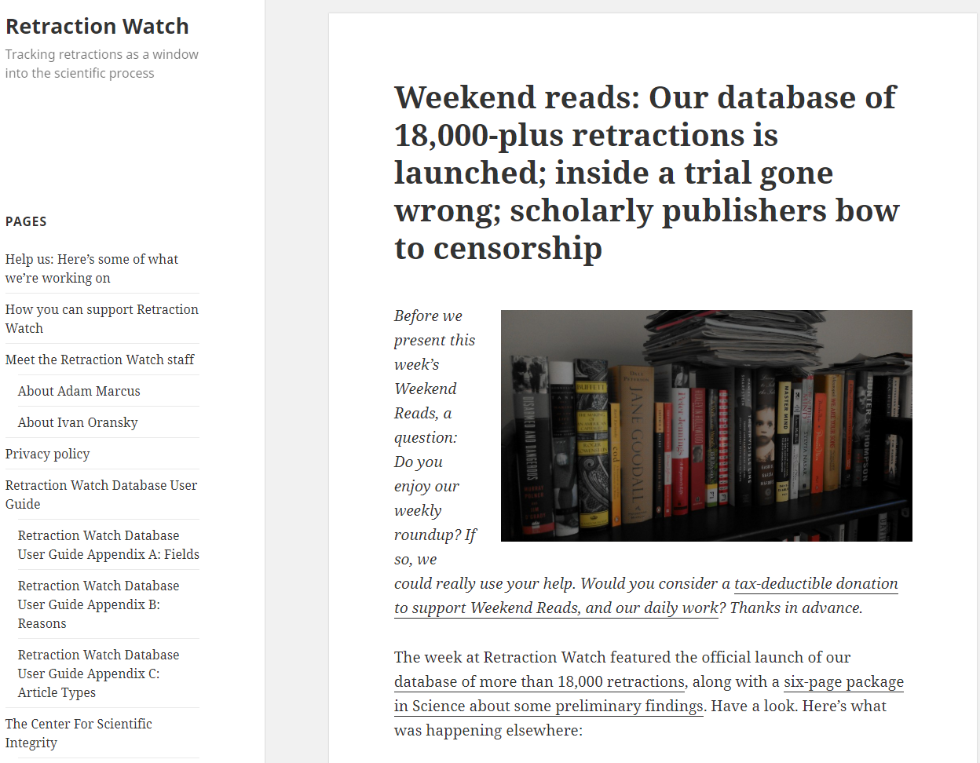
We don’t want you to be on this list!

Slide 13

RECOMMENDATION 4-1:
To help ensure the reproducibility of computational results, researchers should convey clear, specific, and complete information about any computational methods and data products that support their published results in order to enable other researchers to repeat the analysis, unless such information is restricted by nonpublic data policies. That information should include the data, study methods, and computational environment…
National Academies of Sciences, Engineering, and Medicine. (2019). Reproducibility and replicability in science. National Academies Press. https://doi.org/10.17226/25303

Slide 14
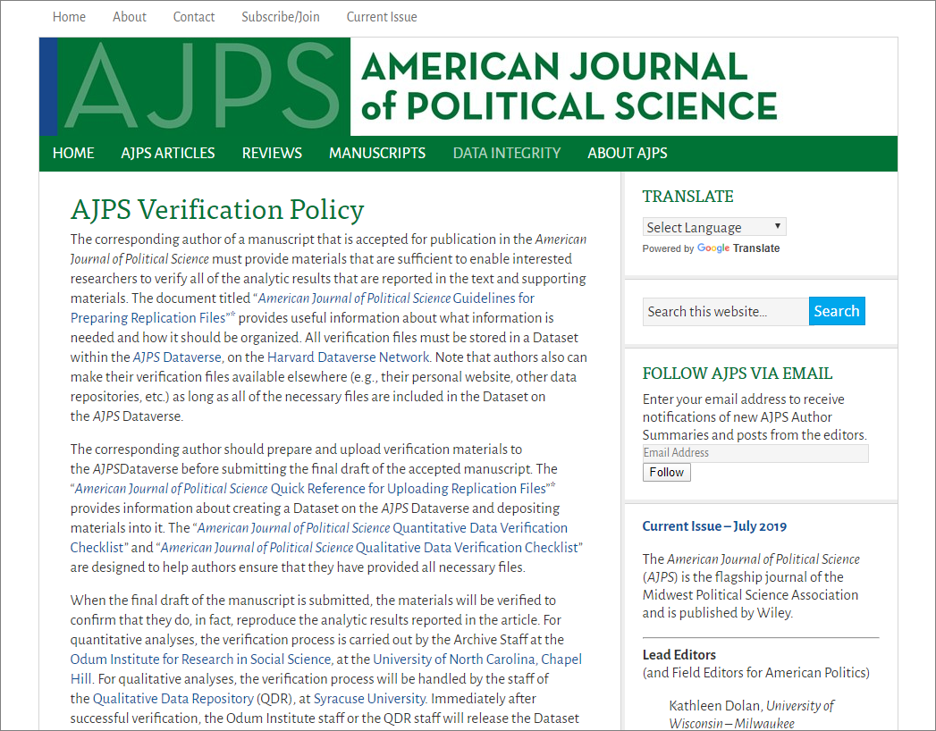
The corresponding author of a manuscript that is accepted for publication in the American Journal of Political Science must provide materials that are sufficient to enable interested researchers to verify all of the analytic results that are reported in the text and supporting materials.
When the final draft of the manuscript is submitted, the materials will be verified to confirm that they do, in fact, reproduce the analytic results reported in the article.

Slide 15
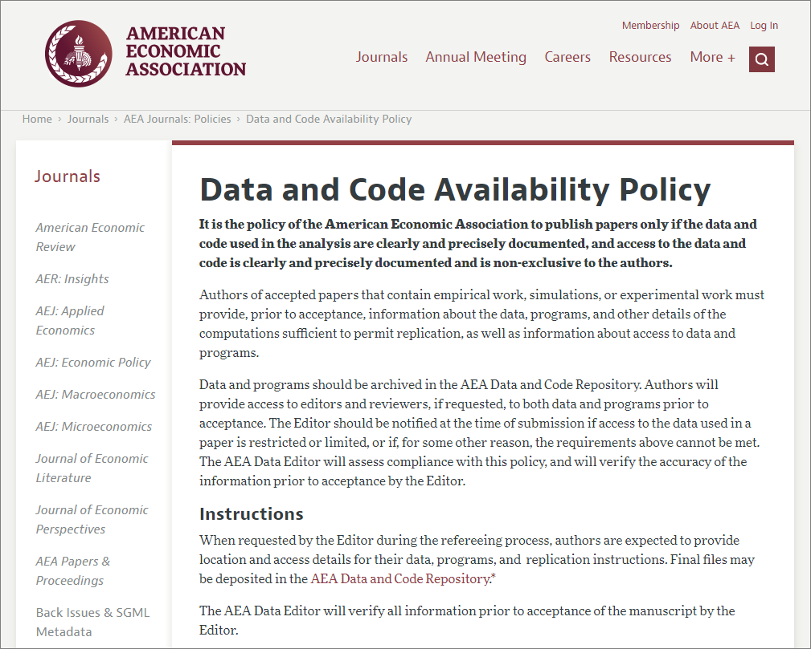
Authors of accepted papers that contain empirical work, simulations, or experimental work must provide, prior to acceptance, information about the data, programs, and other details of the computations sufficient to permit replication, as well as information about access to data and programs.

Slide 16
Funders are Requiring This
NIH: Endorses the sharing of final research data to serve these and other important scientific goals. The NIH expects and supports the timely release and sharing of final research data from NIH-supported studies for use by other researchers.
NSF: Investigators are expected to share with other researchers, at no more than incremental cost and within a reasonable time, the primary data, samples, physical collections and other supporting materials, as well as share software and inventions
Source: https://grants.nih.gov/grants/guide/notice-files/NOT-OD-03-032.html

Slide 17
Why prepare your rm?
For better science
When reproduction materials are available:
Allows scientists to test and replicate each others’ findings
Encourages diversity of analysis and opinions. Researchers having access to the same materials can challenge each other’s analyses and conclusions.
Promotes new research and allows for the testing of new or alternative methods.
Improves methods of data collection and measurement through the scrutiny of others by allowing the scientific community to reach consensus on methods.
Reduces costs by avoiding duplicate data collection efforts.
Provides an important resource for training in research. Secondary data are extremely valuable to students, who then have access to high-quality data as a model for their own work.
Source: https://www.icpsr.umich.edu/icpsrweb/content/deposit/guide/index.html

Slide 18
Reproduction of Results Service (R Squared)

Slide 19
All-in-one service for Results Reproduction
Ensure:
The results reproduce… Peace of mind!
The code works and does not break!
Suggest code improvements
The process is transparent
Publication- and archival-ready, easy-to-use Reproducibility Package
Well-documented, easily-understandable package of Reproduction Materials
Host the Reproducibility Package in the CCSS Data and Reproduction Archive
Create a study catalog
Ease of access to data and code
Provide a DOI for the journal to use
Implement appropriate access settings
Provide alternative metrics

Slide 20
R-squared Workflow
Post-manuscript writing review of RM
2
Identify and apply quality improvement interventions
Client Deposits
R-Squared
Publication
Submission Stage
Check Submission: Complete?
Run Code:
Error-free?
Compare Results:
Identical?
Journal/
ProQuest
Pre-submission
1
No
Assemble Package
Archival Storage & Access
R&R
Yes
Yes
Yes
Client validates and signs off on the package
Yes
Accepted
Versioning
Journal-specified Repository
No
No
No
Optional:
(prep catalog, mint DOI, data availability statement)
Proof
Another package may be created with all or some data removed, but with instructions (data availability statements) on how to get and where to put them in the package, depending on who owns the data used by the author(s).
CISER Data Archive
Discuss with client and make necessary corrections
Post-publication
E-Commons
https://ciser.cornell.edu/research/results-reproduction-r-squared-service/reproduction-materials-review-recommendations/

Slide 21
Priorities
Publication Stage:
1. Accepted
2. R&R or Proof Stage
3. Post-publication
4. Pre-submission
Operating System:
Windows
Others (Let’s chat)
Software:
SAS, SPSS, Stata, R
Others (Let’s chat)
Size of data:
1. Small/Medium
2. Large/Big (Let’s chat)

Slide 22
Demo of completed R-squared project
Reproducibility Package
http://doi.org/10.6077/80ph-y162
https://doi.org/10.7910/DVN/OARGFC
To see more reproducibility packages, go to: https://archive.ciser.cornell.edu
Type R2 on the search box and hit Search

Slide 23
Data Quality Review
Peer, L., Green, A., & Stephenson, E. (2014). Committing to data quality review. International Journal of Digital Curation, 9(1). http://doi.org/10.2218/ijdc.v9i1.317
File Review
Doc Review
Data Review
Code Review
Notes:
Preparing high-quality reproduction materials require that you do a Data Quality Review which includes File Review, Documentation Review, Data Review and Code Review

Slide 24
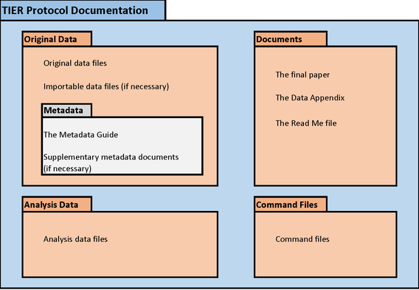
Data Quality Review
Peer, L., Green, A., & Stephenson, E. (2014). Committing to data quality review. International Journal of Digital Curation, 9(1). http://doi.org/10.2218/ijdc.v9i1.317
Check for presence of all (necessary) files
Files in one project folder
Project folder has sub-folders to group files by type e.g., code, original data, analytic data, output, etc.
Has Readme that describes content
(Optional) Make the project folder a git repository so changes can be tracked
File Review
Notes:
Data quality review

Slide 25
Data Quality Review
Peer, L., Green, A., & Stephenson, E. (2014). Committing to data quality review. International Journal of Digital Curation, 9(1). http://doi.org/10.2218/ijdc.v9i1.317
Confirm the presence of comprehensive descriptive information necessary for informed reuse
Data definitions
Variable construction
Methodology
Sampling information
Original data source citation
Analysis software version
Questionnaires, codebooks
Data Availability Statements
Link to related research products
Doc Review
Notes:
Next is review your documents.

Slide 26
10 Tips for Managing and Using Secondary Data
01 | Verify that your intended use is permitted to avoid wasting your time. Read terms and licensing carefully.
02 | Store the working data copy in a separate folder from the original data. Leave the original data untouched and locked.
03 | Set up or confirm that all the folders are being backed up elsewhere.
04 | Start a README to capture data retrieval information, including terms/license if applicable. Update this file as needed.
05 | Read any associated documentation. Add to the README any additional information that did not come with the data.
06 | Explore the data, noting anything that is unclear. Avoid assumptions by contacting the data producer, if possible.
07 | If assumptions were made, document what they are in the README plus any evidence that supports the assumption(s).
08 | Document actions that were taken on the data prior to starting the work (cleaning, corrections, removing unneeded variables, etc.).
09 | Record the file name(s) that will serve as official input/output in the README.
10 | Publish your work, include data preparation in the methods and cite the data source (if possible, formally in the reference list).
Data Review

Slide 27
Data Quality Review
Peer, L., Green, A., & Stephenson, E. (2014). Committing to data quality review. International Journal of Digital Curation, 9(1). http://doi.org/10.2218/ijdc.v9i1.317
Check for undocumented variable and value information
Examine data for inconsistencies and errors
Discrepancies in number of observations
Out-of-range or wild codes
Undefined null values
Review data for confidentiality/intellectual property issues, anonymization
Confirm data is cited in article (and Readme)
Data Review
Notes:
Data quality review

Slide 28
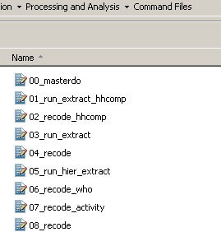
15 Code Review Things
Check file names of codes contain the order of execution, i.e., prefixed with a step ##.
Check for presence of master file that would execute all codes in sequence
Identify software, packages, and OS and their versions required to execute the code.
Code Review
Notes:
Review your code
File names of code are prefixed with the order of execution
Use a Master program file to call all programs used in the study
Note the software, packages, operating used and their versions. And when the code was last executed These are needed should reusers need to rebuild your computing environment.

Slide 29
Convert absolute file paths to relative file paths
Check code for presence of non-executable comments that document analysis processes
Map code processes to paper sections using comments
Remove or comment out unnecessary codes
Label new variables and their values immediately after creation
Code Review
Notes:
Data quality review

Slide 30
***********************************************************
***********************CODE TITLE**************************
***********************************************************
clear
log using “../Output/demoCodeLog.txt", replace text
import delimited “../Original Data/HelloWorld.txt"
//Labeling the variables and values
label variable treatment "The manipulation group"
label define treatment1 1 “Well Documented" 2 “Poorly Documented"
label value treatment treatment1
label variable pieces “Good labels are descriptive but not too long"
label variable gender "Gender"
label define gender1 1 "Male" 2 "Female“
******** Table 1 - Descriptive statistics of the sample
tab mmff
ttest age if mmff ==1 | mmff == 2, by(mmff) unequal
ttest age if mmff ==3 | mmff == 4, by(mmff) unequal
Code Review

Slide 31
Run the code from start to finish, in one go, using a different computer (not the one you used to run you analysis). Rebuild the computing environment if necessary.
Address errors in code. Repeat until no more errors are encountered.
Note in the code the date you last executed your code from start to finish.
Compare code output to findings presented in article.
Code generates output in the same order as they appear on the manuscript (if possible)
Code Review
Notes:
Data quality review

Slide 32
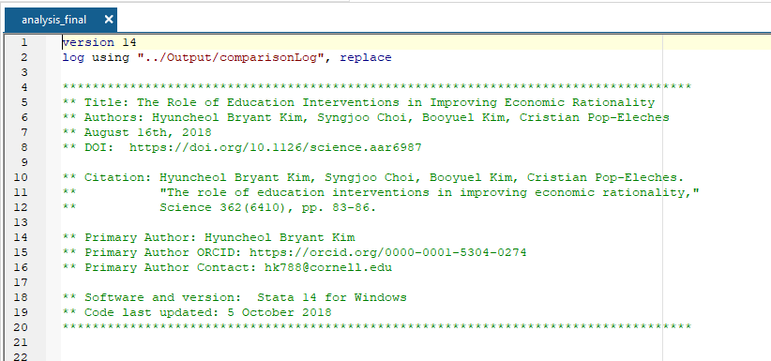
14. Insert a Code Metadata Header
Title of study
Author(s)
Article Citation (with DOI)
Primary author contact info and ORCID
Date code last updated
Date code last executed
Code citation (with DOI)
Code license
Character Encoding
Software, version, OS
Code Review
Notes:
Insert a code header with the following information for researchers to be able to cite the article and code, contact the author, and know the computing environment in which this code was last updated or executed.

Slide 33
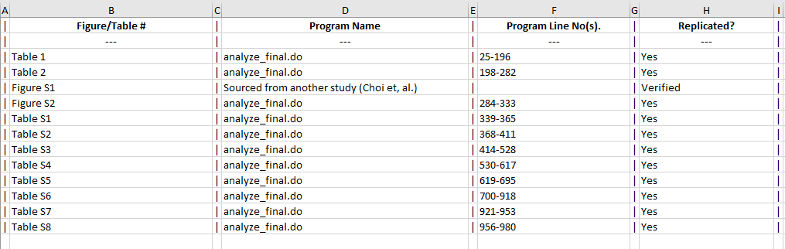
15. Create a Manuscript-Code-Output Checklist
Manuscript-Code-Output_Checklist.xlsx
Code Review
Notes:
Create Manuscript-Code-Output Checklist (Optional) where you list the tables, figures, and in-text numbers created by the code, specify the code and line number that created them, and verify and certify that they were replicated.

Slide 34
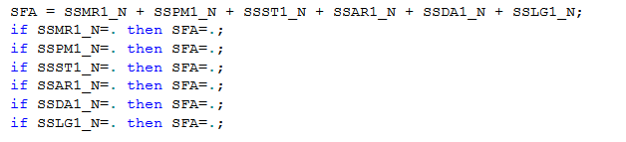
Glaring code inefficiencies
None of the IF statements in this SAS code are needed because the first statement, which creates the variable SFA, uses an arithmetic expression and would result to missing if one of the variables in the expression is missing.
SFA = sum(SSMR1_N, SSPM1_N, SSST1_N, SSAR1_N, SSDA1_N, SSLG1_N)
SFA = sum(SSMR1_N, SSPM1_N, SSST1_N, SSAR1_N, SSDA1_N, SSLG1_N, na.rm=TRUE)

Slide 35
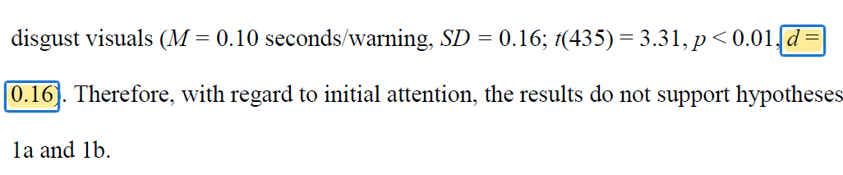
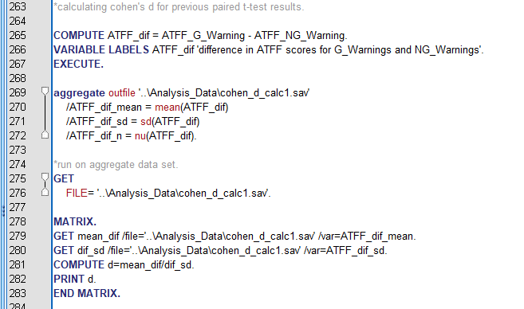
Hardcoded values
Some values just mysteriously appear in the code or in the manuscript.
Reason: Researchers do not know how to code it in their choice software.
Solution: Figure out how it can be done in your choice software. As much as possible use only one software to run your analysis
Why do it? More automation less human intervention– faster to reproduce, science also moves forward faster

Slide 36
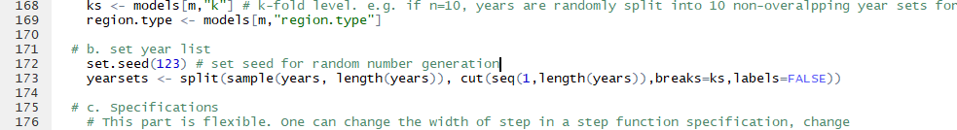
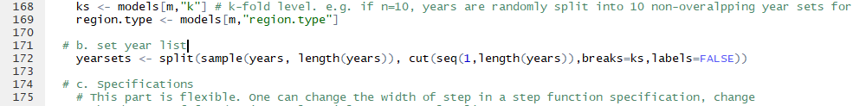
Lack of Seed
Any random generation requires a seed or else it can have different results and won't be reproduced.
Notes:
Monte Carlo simulations or other simulations require the use of random numbers. However because of their random nature, each time you run them you will get different results unless you use a seed. A given seed causes all the random numbers generated to be the same as the next time you use the seed, so while the 1st and nth numbers aren't the same, every time you run the code the 1st and nth numbers will be the same as every other 1st and nth numbers. This allows reproducibility even with models using simulation. Ideally there won't be significant differences between using a seed and not using one, however it is impossible to check the work properly without a seed being given.

Slide 37
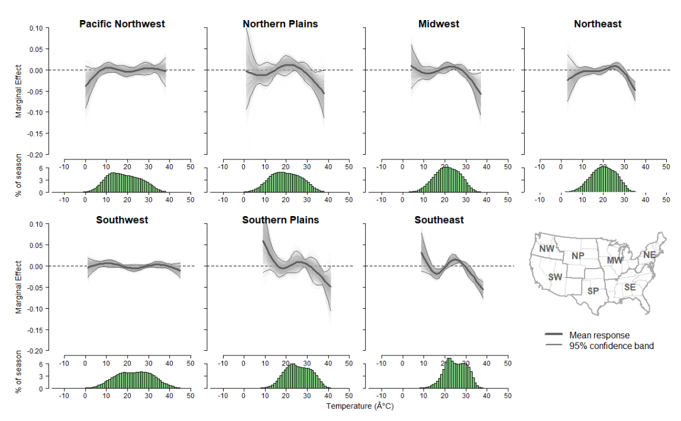
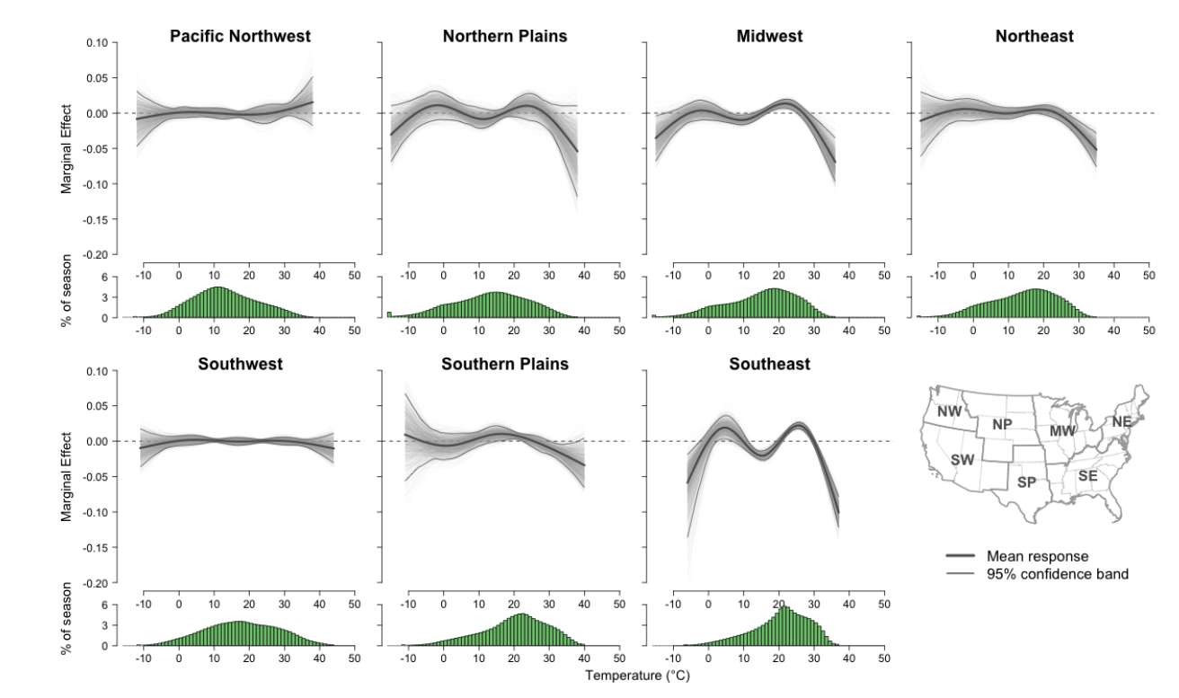
Lack of Seed
Any random generation requires a seed or else it can have different results and won't be reproduced. Example top-right is without the seed and bottom-right is with it.

Slide 38
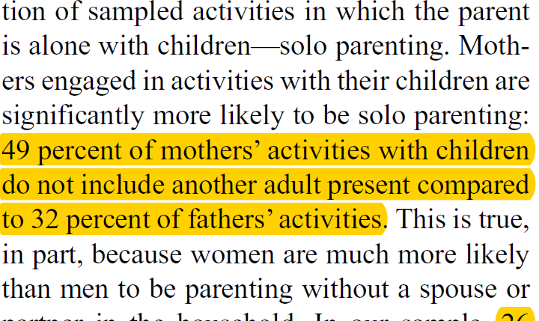
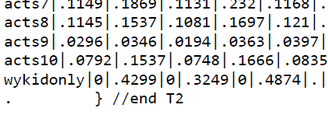
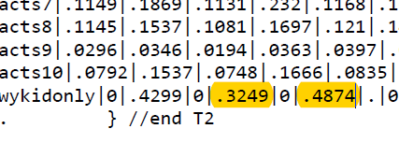
MANUSCRIPT AND OUTPUT REVIEW
Highlight on your manuscript all sections (e.g., paragraphs, sentences, tables, charts) and in-line text that reference output derived from your data.
In the output file, highlight the numbers,
tables, figures, charts used in your manuscript
Highlight sections stating that methodological assumptions were assessed
For example: “Normality was assessed for the distribution of all
continuous variables of interest” – show proof in your code
Highlight operationalization of variables
For example: “We defined obese as BMI > 28…”
– inspect your code
Highlight claims of additional analyses, but not shown, and promising to make them available upon request
For example: “In some additional analysis (not shown), but available upon request…”
-- reproduction materials for that should be inspected as well.
Notes:
Review the manuscript and output

Slide 39
Readme – Instructions to reproduce the study
Instructions to reproduce the study
Title of study
Author(s) and their ORCIDs
Article Citation (with DOI)
Primary author contact info and ORCID
Data Availability Statement for each Dataset
Data Citation (with DOI), license, and version
Code Citation (with DOI), license, software, version, and last updated
Code-output table – list of table, figure, in-text numbers in manuscript and which code produced them.
Errata (post-publication reproduction)

Slide 40
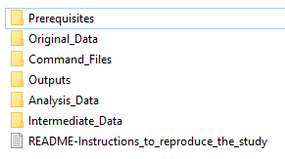
Organize and Package the Reproduction Materials
If files are unorganized within the project folder, we use TIER Protocol (projectier.org).
2. If files are organized within project folder, retain
researcher’s existing structure
Add a Prerequisites folder to store the version of
the libraries, packages, ados that researchers used
to generate their results
In R, we use Checkpoint
In Stata, we redirect the PLUS folder to the
Prerequisites folder
Example of our expanded TIER structure

Slide 41
Validate
Have a trusted colleague or third-party run the reproducibility package and verify no errors are encountered and results are reproduced exactly.
CISER can be the third-party with its Results Reproduction (aka R-squared) service.
https://ciser.cornell.edu/research/results-reproduction-r-squared-service/
Trust nothing. Validate everything!

Slide 42
Deposit RM in a Digital Repository
Make your RM easily Findable, Accessible, and Reusable by depositing them in a trusted digital repository
Create catalog for replication materials
Assign persistent identifier (DOI) for journals to use to link the article to its associated replication materials.

Slide 43

Most Common Error Types present in Manuscripts
Rounding
Typos
Misidentification
Out of-Date Tables
Missing from Package
Incorrectly Marking p-values

Slide 44
Rounding
Extremely common and easy to miss
Different software/people round in different ways, compounding if it is an error or difference of style
However inconsistent rounding is always a problem
Double rounding can cause errors as well

Slide 45
Typos
Sometimes obvious, such as missing a decimal place when all the others have it
Can also just be a mistyped number or two

Slide 46
Misidentification
(looking at wrong cell in output file)
Very easy when there aren’t output management software/practices
Difficult to detect from repeated checks, as the number is present on the output page, but simply is not the result that should be included

Slide 47
Out of Date Tables
Descriptive Tables are most common culprit
Researchers will generate their descriptive tables and then further clean data
Can be calculated inconsistently as well, such as valid vs total percentage
Plenty of other tables can have this happen as well, as researchers often don’t re-run their entire code (especially for long execute times)

Slide 48
Missing From Package of Scripts
Can be similar to “hard coded variables” in that the calculation just done by hand/excel and put into the manuscript
Very common with regards to figures as they are often edited or done in non- or different statistical package programs (such as excel) and then edited to look better

Slide 49
Incorrectly Marking P-Values
Often happens with regards to rounding
0.045 rounds to 0.05 but should be marked as ≤ 0.05, but can mistakenly be marked as =0.05
0.051 shouldn’t be marked as ≤0.05, as it is >0.05
Can come from inconsistency of having multiple people doing the tables
Easy to make one of the other errors

Slide 50
Most Common Error Types present in Scripts
Not calling the data initially
Hard Coded Variables
Missing Files/Commands
No (or poor) Commenting
Uncertain Order of Execution
Does not follow the order of the Output
Prerequisites
Extraneous output/lines of code

Slide 51
Not calling the data initially
Many clients simply open the data with the GUI instead of via code
Can cause confusion when there are multiple data files present (including raw data, cleaned data, intermediate data, data from different sources, etc.)

Slide 52
Hard Coded Variables
Generally done either by hand calculator or Excel and results entered into program file
Can cause errors when data is further refined or if mistake was made when calculating it
Causes confusion as to where the number came from and what it represents

Slide 53
Missing Files/Commands
Impossible to fully reproduce results with needed files/commands missing
Often because researchers will work on multiple computers or utilize poor version control and delete things
Can also be caused by hard coding a variable and then discarding the code or by using the GUI and not pasting the commands

Slide 54
Poor or No Commenting and Poor Variable Names
People will write the code for themselves, and thus commenting can tend to fall by the wayside instead of commenting as they go
What makes sense to someone who has worked with the code/data for four years may not make sense to someone else and may need further explanation

Slide 55
Uncertain or No Order Specified in Title of Scripts
Researcher knows the steps in running the program files so doesn’t order them
Alternatively, they know the step, yet use confusing names such as “first-first…” vs “actually-first…” vs “initialize…”
Should have numerical component e.g. Step1... Or 1_1-cleaning…
If not run on a 'clean install' then can have previously generated results affect outcomes

Slide 56
Doesn’t Follow the Order of the Manuscript
Things are rarely coded in the exact order they appear in the manuscript and can be impossible to do so. However, having the results generally follow the manuscript will dramatically increase transparency
Often calculated on other computers and then the code thrown together to put everything in the same script file

Slide 57
Prerequisites (ado, library, extension, etc.)
The idea of reproducibility is it will work on any computer and without the list of prerequisites, that will not work
Very easy to forget as they don’t need to be reinstalled from project to project
Prone to breaking things when they, or the base software gets updated, so having unneeded ones can be problematic

Slide 58
Extraneous outputs/lines of code
Makes the code and output files longer and unnecessarily confusing
Not very transparent to have outputs that are not used/needed
Can cause mis-identification or other issues detailed in the common errors in manuscript.
Time consuming on both the re-user and checker’s.

Slide 59
Comments not updated
Comments have typos
Comment that map the location of the output to the paper is still pointing to old location of the output in the paper
Comment that map the location of the output to the paper still has the old name of the table/figure.
Comments have names of people who are not authors of the study (looks like they were notes about respondents or interviewers).

Slide 60
Hands-on: Data & code review
Distribute the handouts and introduce/begin first exercise

Slide 61
Hands-on 1: Data and Code Review
Hands on with Relative Paths
Open the StudyFiles_Practice folder
Take a minute to familiarize yourself, see how each folder is clearly labeled and it is clear what goes where, with a readme in the top level. Note the TIER Protocol.
Now navigate back up to the top level and open the “Command Files” folder
Note how the file order is designated by a number.
Open the first file titled “1-import-wdi” by double-clicking on it. This will also make the Command-Files folder the active directory.
Try to run the code
Shouldn’t work because of absolute paths

Slide 62
Hands-on 1: Data and Code Review
Hands on with Relative Paths (cont.)
To change everything from absolute to relative paths, we want to do a find/replace
To do this, push ‘ctrl’ + ‘h’ and fill in the appropriate fields (U:/foa2/Documents/TIER Protocol/) and (../) respectively
Now try to execute the code. It should work on everyone’s machine despite every path being different. This is the power of relative paths.

Slide 63
Hands-on 2: Data and Code Review Master Files
Master Files can help with reproduction and transparency
Show the exact order things get done, make it extremely easy to do, just execute one file and produce the results in your manuscript
Relatively easy and recommended when dealing with just a single programing language, more difficult but still do-able with different languages

Slide 64
Hands-on 2: Data and Code Review Master Files (cont.)
Create a new do file “Master.do”
On the main toolbar, locate and click on New Do-File Editor
Type out
log using "../Documents/log.txt" do 1-import-wdi.do
do 2-import-pew.do
do 3-processing.do
do 4-data-appendix.do
do 5-analysis.do
log close
Save the do file as Master.do – Click File>Save As>Master.do
The command to run other files in Stata is “do”

Slide 65
Hands-on 3: Data and Code Review
Ados and Prerequisites
I already changed the rest of the code to be relative paths for you, so the code for 2 through 4 should work.
However, 5 has an ado requirement and won’t run properly. To get around this, most people just list out the prerequisites that are needed and rely on the reproducers to get the files themselves
However, that can be difficult. As software updates, the add-ons get updated too, but your code won’t. Is there a way to solve both the problem of requiring downloads and versioning?
Yes!
Prerequisites folder preparation

Slide 66
Hands-on 3: Data and Code Review
Ados and Prerequisites (cont.)
The first step is to designate a new folder as your “PLUS” folder. This can be done in every statistics language, but is called different things depending on what software it is. (R calls them libraries, etc.) However fundamentally they are the same thing.
Make a new subfolder in the StudyFiles_Practice folder called “Prerequisites”
It should appear below the “Original-Data” folder
Now type into stata the following set of commands: sysdir set PLUS ../Prerequisites ssc install outreg2
This will install the missing ado and put it in the Prerequisites folder you just created, now all your code will work. However, let’s do two more things.

Slide 67
Hands-on 4: Data and Code Review Saving Outputs Mapped to Manuscript
Save the figures generated by the code into the documents folder, so all outputs are generated by the code and don’t need to keep the code open
In the 5-Analysis.do file, add the following code after the scatter command in Figure 1.
graph export ../Documents/figure1.png
Add the following code after the scatter command in Figure 2.
graph export ../Documents/figure2.png

Slide 68
Hands-on 5: Data and Code Review Output comparison
Run the Master.do file.
Examine the log file handouts. Compare the Highlighted_Comparison_Output_File.pdf and log.txt file.

Slide 69
Hands-on 5: Data and Code Review Output comparison (cont.)
Examine the outreg2 output
Compare this with the standard regression output in the log.txt file (towards the bottom of the file). Automatically outputting it to xml with outreg2 allows for much more organized and neat outputs while preserving everything you do in the code
Automatically marks significance levels etc.
There are similar programs in most statistical software if you look for them, can be very helpful

Slide 70
Hands-on 6: Data and Code Review Readme
Good transparency requires a good readme file
However what should be in this readme is up for debate and depends on your field
Generally speaking it should explain concisely and completely explain your file structure, how to get started, and explain any additional files needed
This is the first point of contact with users and thus needs to be both a guide and a place they can turn to for help

Slide 71
Hands-on 6: Data and Code Review Readme
Write it in plain text or markdown format
Instructions to reproduce the study
Manifest (contents of the reproducibility package)
Article citation (if known)
Data Citation and License
Code Citation and License
Computing Environment
Tables/Figures and corresponding Code and Line number(s) that produced them
Errata (if post publication replication)

Slide 72
Discussion/Questions

Slide 73
THANK YOU
Feedback welcome and encouraged!
<link to workshop evaluation form>
Florio Arguillas, Ph.D.
foa2@cornell.edu

